Slide 1
Chapter 6
Combinational-Circuit Building Blocks

Slide 2
Introduction
So far we have studied the basic techniques for design of logic circuits.
In this chapter you will learn about:
Commonly used combinational sub circuits that are used as building blocks in larger designs.
Multiplexers, which can be used for selection of signals and for implementation of general logic functions
Circuits used for encoding, decoding, and code-conversion purposes

Slide 3
Multiplexers
In computer systems it is often necessary to choose data from exactly one of a number of possible sources.
Multiplexers do that job
A multiplexer circuit has a number of data inputs, one or more select inputs, and one output.
It passes the signal value on one of the data inputs to the output.
The data input is selected by the values of the select inputs.

Slide 4
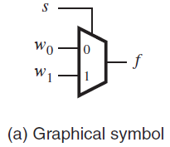
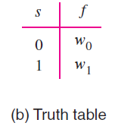
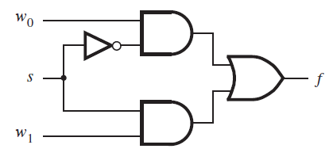
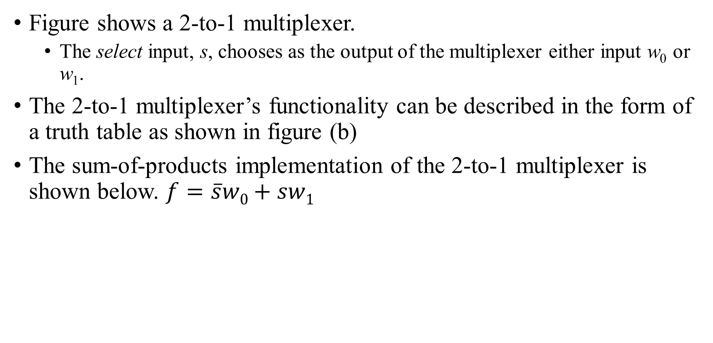
2-to-1 multiplexer
Figure shows a 2-to-1 multiplexer.
The select input, s, chooses as the output of the multiplexer either input w₀ or w₁.
The 2-to-1 multiplexer’s functionality can be described in the form of a truth table as shown in figure (b)
The sum-of-products implementation of the 2-to-1 multiplexer is shown below. $f=\overline{s}w0+sw1$

Slide 5
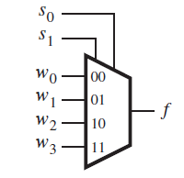
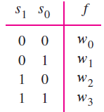
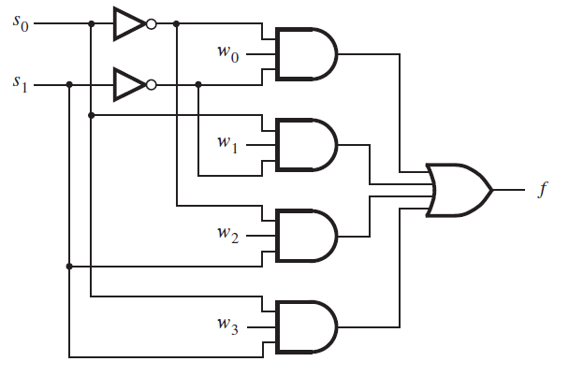
4-to-1 multiplexer.
It has 4 data inputs, w₀, w₁ , w₂ and w₃, and 2 select inputs, s₁ and s₀.
Two-bit number represented by s₁s₀ selects one of the data inputs as the output of the multiplexer.
Circuit shows the sum-of-products implementation of the 4-to-1 multiplexer.
It realizes the multiplexer function

Slide 6
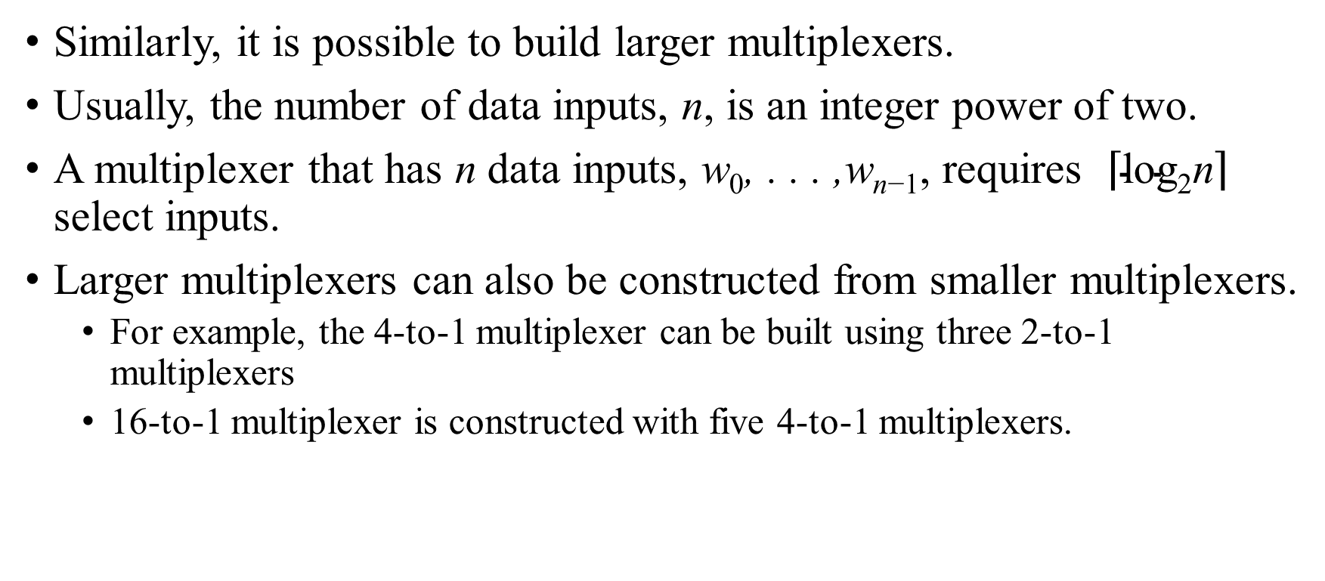
Larger Multiplexers
Similarly, it is possible to build larger multiplexers.
Usually, the number of data inputs, n, is an integer power of two.
A multiplexer that has n data inputs, w₀, . . . ,w_{n−1}, requires $\left\lceil \text{log}\text{2}\text{n}\right\rceil$ select inputs.
Larger multiplexers can also be constructed from smaller multiplexers.
For example, the 4-to-1 multiplexer can be built using three 2-to-1 multiplexers
16-to-1 multiplexer is constructed with five 4-to-1 multiplexers.

Slide 7
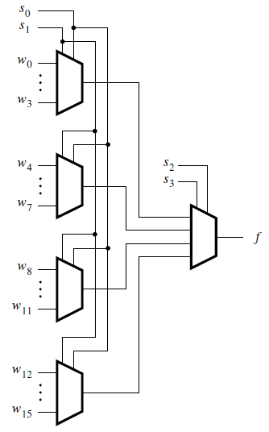
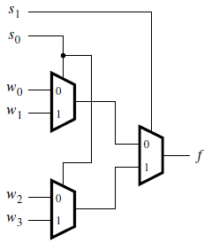
Larger multiplexers using smaller multiplexers
Using 2-to-1 multiplexers to build a 4-to-1 multiplexer
Using 4-to-1 multiplexers to build a 16-to-1 multiplexer

Slide 8
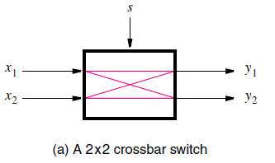
Practical application of multiplexers.
Figure (a) shows a circuit that has two inputs, x₁ and x₂, and two outputs, y₁ and y₂.
The function of the circuit is to allow either of its inputs to be connected to either of its outputs, under the control of another input, s.
A circuit that has n inputs and k outputs, whose function is to connect any input to any output is referred to as an n×k crossbar switch.
Crossbars of various sizes can be created, with different numbers of inputs and outputs.
When there are two inputs and two outputs, it is called a 2×2 crossbar

Slide 9
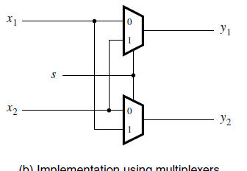
Contd.
Figure shows how the 2×2 crossbar can be implemented using 2-to-1 multiplexers.
The multiplexer select inputs are controlled by the signal s.
If s = 0, the crossbar connects x₁ to y₁ and x₂ to y₂.
else if s = 1, the crossbar connects x₁ to y₂ and x₂ to y₁.
Crossbar are used in many practical applications in which it is needed to connect one set of wires to another set of wires, where the connection pattern changes from time to time.
E.g. Telephone switching

Slide 10
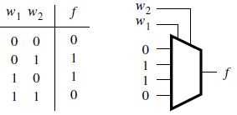
Synthesis of Logic Functions Using Multiplexers
Multiplexers can also be used to synthesize logic functions.
The truth table defines the function f = w₁ ⊕ w₂.
This function can be implemented by a 4-to-1 multiplexer in which the values of f in each row of the truth table are connected as constants to the multiplexer data inputs.
The multiplexer select inputs are driven by w₁ and w₂.
Thus for each valuation of inputs, the output f is equal to the function value in the corresponding row of the truth table.

Slide 11
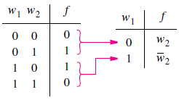
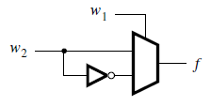
Contd.
The previous implementation is straightforward, but it is not very efficient.
A better implementation can be derived by manipulating the truth table as indicated as shown.
It allows f to be implemented by a single 2-to-1 multiplexer.
One of the input signals, w₁ in this example, is chosen as the select input of the 2-to-1 multiplexer.
The truth table is redrawn to indicate the value of f for each value of w₁.
When w₁ = 0, f has the same value as input w₂, and when w₁ = 1, f has the value of w₂.
The circuit that implements this truth table.
This procedure can be applied to synthesize a circuit that implements any logic function.

Slide 12
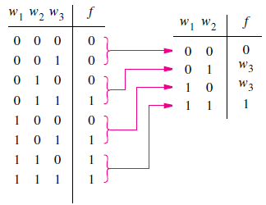
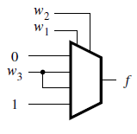
Implementation of the three-input majority function using a 4-to-1 multiplexer
The truth table for the three-input majority function is as shown
Truth table can be modified to implement the function using a 4-to-1 multiplexer.
Any two of the three inputs may be chosen as the multiplexer select inputs.
Here, w₁ and w₂ are chosen
So, we get the circuit as shown

Slide 13
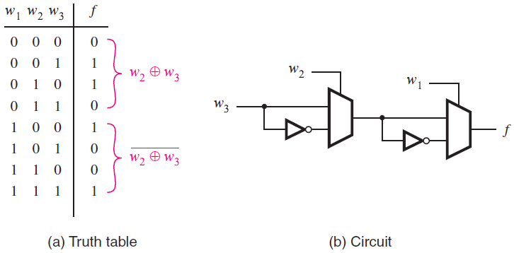
Three-input XOR implemented with 2-to-1 multiplexers.
The function f = w₁ ⊕ w₂ ⊕ w₃ can be implemented using 2-to-1 multiplexers.
When w₁ = 0, f is equal to the XOR of w₂ and w₃, and when w₁ = 1, f is the XNOR of w₂ and w₃.
In the corresponding circuit, the left multiplexer in the circuit produces w₂ ⊕ w₃ and the right multiplexer uses the value of w₁ to select either w₂ ⊕ w₃ or its complement.

Slide 14
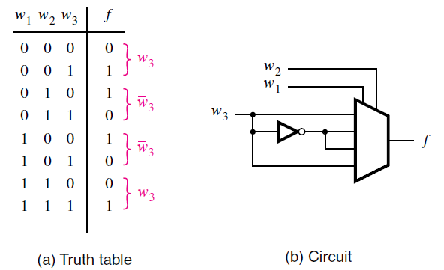
Three-input XOR implemented with a 4-to-1 multiplexer.
Figure gives an implementation of the three-input XOR function using a 4-to-1 multiplexer.
Choosing w₁ and w₂ for the select inputs results in the circuit shown.

Slide 15
Logic functions as combination of multiplexers and other logic gates.
It is also possible to connect more complex circuits as inputs to a multiplexer,
Which allows functions to be synthesized using a combination of multiplexers and other logic gates.
Suppose that we want to implement the three-input majority function using a 2-to-1 multiplexer
The truth table can be modified for this purpose.

Slide 16
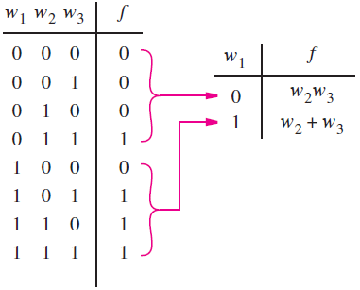
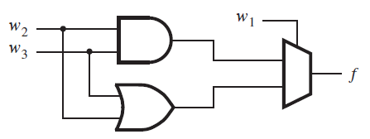

The three-input majority function implemented using a 2-to-1 multiplexer.
If w₁ = 0, then f = w₂w₃, and
if w₁ = 1, then f = w₂ + w₃.
Using w₁ as the select input for a 2-to-1 multiplexer leads to the circuit as shown
This implementation can be derived using algebraic manipulation as well.
The function is expressed in SOP as,
It can be manipulated as,

Slide 17
Multiplexer Synthesis Using Shannon’s Expansion
Multiplexer implementations of logic functions require that a given function be decomposed in terms of the variables that are used as the select inputs.
This can be accomplished by means of a theorem proposed by Claude Shannon known as Shannon expansion theorem.
It states that, any Boolean function f (w₁, . . . ,w_{n}) can be written in the form,
This expansion can be done in terms of any of the n variables.

Slide 18

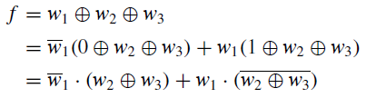
Shannon’s Expansion Theorem
We can apply the theorem to the three-input majority function as,
f (w₁, w₂, w₃) = w₁w₂ + w₁w₃ + w₂w₃
Expanding this function in terms of w₁ gives
which is the expression that we derived earlier.
For the three-input XOR function, we have

Slide 19
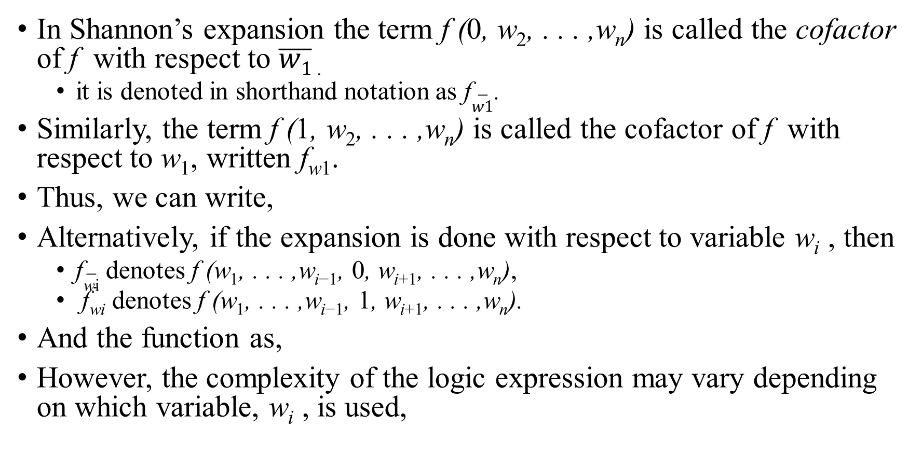
Contd.
In Shannon’s expansion the term f (0, w₂, . . . ,w_{n}) is called the cofactor of f with respect to $\overline{w1}$ .
it is denoted in shorthand notation as f$\overline{w1}$.
Similarly, the term f (1, w₂, . . . ,w_{n}) is called the cofactor of f with respect to w₁, written f_{w1}.
Thus, we can write,
Alternatively, if the expansion is done with respect to variable w_{i} , then
f$\overline{\text{w}\text{i}}$ denotes f (w₁, . . . ,w_{i−1}, 0, w_{i+1}, . . . ,w_{n}),
f_{wi} denotes f (w₁, . . . ,w_{i−1}, 1, w_{i+1}, . . . ,w_{n}).
And the function as,
However, the complexity of the logic expression may vary depending on which variable, w_{i} , is used,

Slide 20

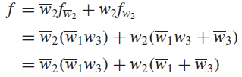

Example 1
Consider the function , If we decompose using w₁, we get
Using w₂ instead of w₁ produces
Finally, using w₃ gives
The results generated using w₁ and w₂ have the same cost, but that using w₃ has a lower cost.

Slide 21
Contd.
Shannon’s expansion can be done in terms of more than one variable too.
For example, expanding a function in terms of w₁ and w₂ gives
This expansion gives a form that can be implemented using a 4-to-1 multiplexer.
If Shannon’s expansion is done in terms of all n variables, then the result is the canonical sum-of products form.

Slide 22
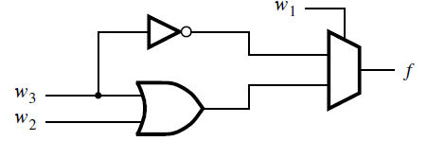

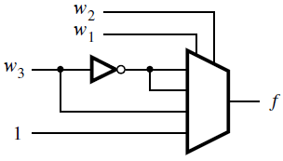

Example 2
Assume that we wish to implement the function
using a 2-to-1 multiplexer and any other necessary gates.
Shannon’s expansion using w₁ gives
The corresponding circuit is shown in figure (a),
Assume now that we wish to use a 4-to-1 multiplexer instead. So, further decomposition using w₂ gives,
The corresponding circuit is shown in figure (b),
figure (a)
figure (b)

Slide 23
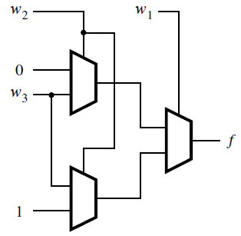


Example 3
Consider the three-input majority function, f (w₁, w₂, w₃) = w₁w₂ + w₁w₃ + w₂w₃.
We wish to implement this function using only 2-to-1 multiplexers.
Shannon’s expansion using w₁ yields
Let g = w₂w₃ and h = w₂ + w₃. Expansion of both g and h using w₂ gives

Slide 24
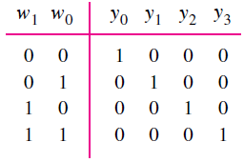
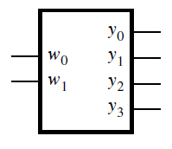
Decoders
A 2-to-4 decoder.
Consider the truth table:
It has two inputs, w₁ and w₀, and four outputs, y₀, y₁, y₂ and y₃
only one of the outputs is asserted at a time.
Setting the inputs w₁w₀ to 00, 01, 10, or 11 causes the output y₀, y₁, y₂, or y₃ to be set to 1, respectively.
This type of circuit is called a binary decoder.
Its inputs represent a binary number, which is decoded to assert the corresponding output.
Graphical symbol

Slide 25
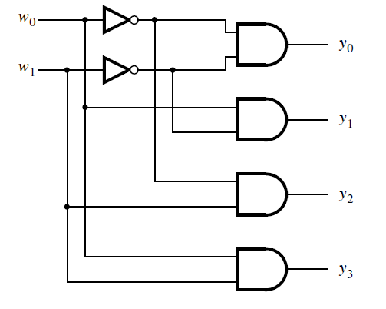
Contd.
The circuit for the decoder is as below,
Each output is driven by an AND gate that decodes the corresponding valuation of w₁w₀.

Slide 26
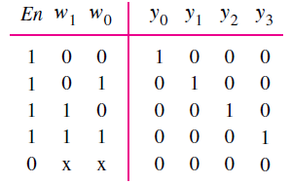
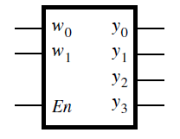
Decoder with Enable control
It is useful to include an enable input, En, in a decoder circuit.
When enabled by setting En = 1 the outputs are asserted as per the input valuations
But, if it is disabled by setting En = 0, then none of the outputs are asserted.
Only five rows are shown in the truth table, because if En = 0 then all outputs are equal to 0 regardless of the values of w₁ and w₀.
Graphical symbol

Slide 27
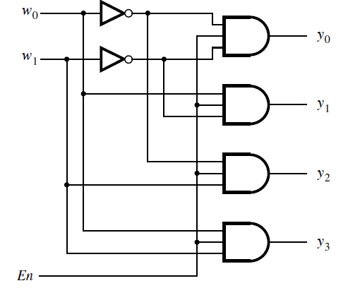
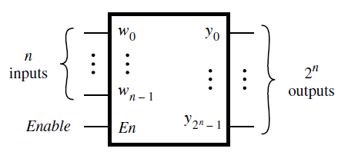
Decoder with Enable control – Circuit diagram
Connecting the Enable input directly with all the AND gates, we can get the circuit
Larger decoders like 3-to-8 or 4-to-16 etc.. can be built using similar sum-of-products structure
n-to-2^{n} binary decoder

Slide 28
One-hot encoding
A k-bit binary code in which exactly one of the bits is set to 1 at a time is referred to as one-hot encoded
meaning that the single bit that is set to 1 is deemed to be “hot.”
The outputs of an enabled binary decoder are one-hot encoded.
In general, decoders can be designed to have either active-high or active-low outputs.
In our discussion, we have assumed that active-high outputs are needed.

Slide 29
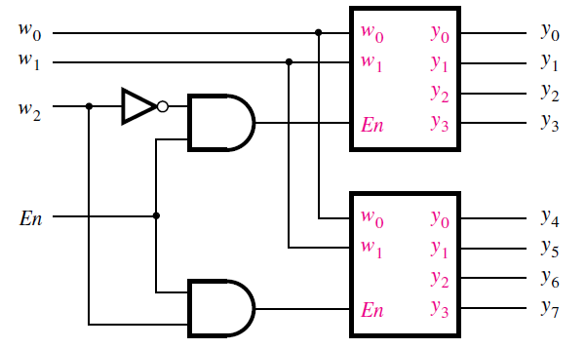
A 3-to-8 decoder using two 2-to-4 decoders
Larger decoders can also be constructed from smaller decoders.
Figure shows how a 3-to-8 decoder is built with two 2-to-4 decoders.
The w₂ input drives the enable inputs of the two decoders.
The top decoder is enabled if w₂ = 0, and the bottom decoder is enabled if w₂ = 1.

Slide 30
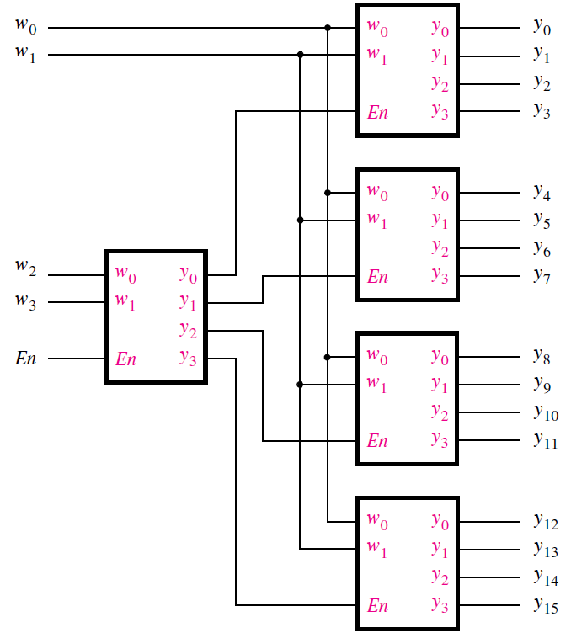
A 4-to-16 decoder built using a decoder tree
Figure shows how five 2-to-4 decoders can be used to construct a 4-to-16 decoder.
Because of its treelike structure, this type of circuit is often referred to as a decoder tree.

Slide 31
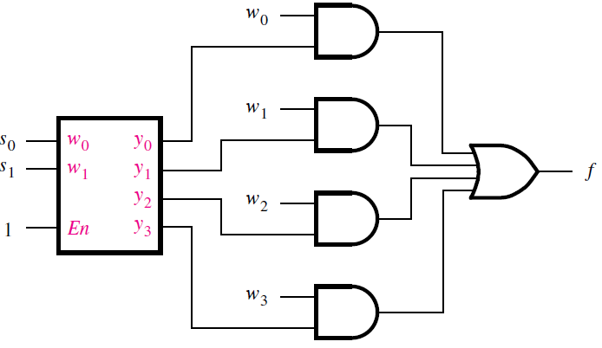
Decoder as Multiplexer
Decoders are useful for many practical purposes.
For example, decoder can be used to build a multiplexer.
The enable input of the decoder is not needed in this case, and it is set to 1.
The four outputs of the decoder represent the four valuations of the select inputs.
A 4-to-1 multiplexer built using a decoder

Slide 32
Demultiplexers
The purpose of the multiplexer circuit is to multiplex the n data inputs onto the single data output under control of the select inputs.
A circuit that performs the opposite function, namely, placing the value of a single data input onto multiple data outputs, is called a demultiplexer.
The demultiplexer can be implemented using a decoder circuit.
For example, the 2-to-4 decoder can be used as a 1-to-4 demultiplexer.
In this case the En input serves as the data input for the demultiplexer, and the y₀ to y₃ outputs are the data outputs.
The valuation of w₁w₀ determines which of the outputs is set to the value of En.
When En = 0, all the outputs are set to 0, including the one selected by the valuation of w₁w₀.
When En = 1, the valuation of w₁w₀ sets the appropriate output to 1.
In general, an n-to-2^{n} decoder circuit can be used as a 1-to-n demultiplexer.
But, in practice decoder circuits are used much more often as decoders rather than as demultiplexers.

Slide 33
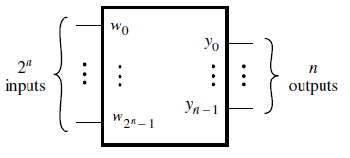
Encoders - Binary Encoders
An encoder performs the opposite function of a decoder. It encodes given information into a more compact form.
A binary encoder encodes information from 2^{n} inputs into an n-bit code.
Exactly one of the input signals should have a value of 1, and the outputs present the binary number that identifies which input is equal to 1.
Encoders are used to reduce the number of bits needed to represent given information.
A 2^{n}-to-n binary encoder

Slide 34
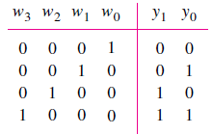
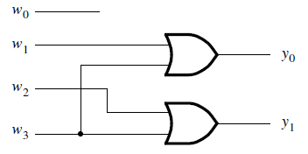
4-to-2 binary encoder.
The truth table for a 4-to-2 encoder is shown in Figure.
The output y₀ is 1 when either input w₁ or w₃ is 1, and output y₁ is 1 when input w₂ or w₃ is 1.
Hence these outputs can be generated by the circuit in Figure.
Note that we assume that the inputs are one-hot encoded.
All input patterns that have multiple inputs set to 1 are not shown in the truth table, and they are treated as don’t-care conditions.
A practical use of encoders is for transmitting information in a digital system.
Encoding the information allows the transmission link to be built using fewer wires.
Encoding is also useful if information is to be stored for later use because fewer bits need to be stored.

Slide 35
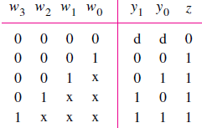
Priority Encoders
In a priority encoder each input has a priority level associated with it.
The encoder outputs indicate the active input that has the highest priority.
When an input with a high priority is asserted, the other inputs with lower priority are ignored.
The truth table for a 4-to-2 priority encoder is shown in Figure
It assumes that w₀ has the lowest priority and w₃ the highest.
The outputs y₁ and y₀ represent the binary number that identifies the highest priority input set to 1.
Since it is possible that none of the inputs is equal to 1, an output, z, is provided to indicate this condition.
It is set to 1 when at least one of the inputs is equal to 1.
It is set to 0 when all inputs are equal to 0.
The outputs y₁ and y₀ are not meaningful in this case, and hence the first row of the truth table can be treated as a don’t-care condition for y₁ and y₀.

Slide 36
Contd.
The behavior of the priority encoder is most easily understood by first considering the last row in the truth table.
It specifies that if input w₃ is 1, then the outputs are set to y₁y₀ = 11.
Because w₃ has the highest priority level, the values of other inputs do not matter and are kept as x.
The second-last row in the truth table stipulates that if w₂ = 1, then the outputs are set to y₁y₀ = 10, but only if w₃ = 0.
Similarly, input w₁ causes the outputs to be set to y₁y₀ = 01 only if both w₃ and w₂ are 0.
Input w₀ produces the outputs y₁y₀ = 00 only if w₀ is the only input that is asserted.

Slide 37
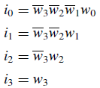
Contd.
A logic circuit that implements the truth table can be synthesized by using the techniques developed in earlier chapters.
However, a more convenient way to derive the circuit is to define a set of intermediate signals, i₀,i₁,i₂ & i₃, such that:
Each signal, i_{k}, is equal to 1 only if the input with the same index, w_{k}, represents the highest-priority input that is set to 1.
The logic expressions for i₀, . . . , i₃ are
Using the intermediate signals, the rest of the circuit for the priority encoder has the same structure as the binary encoder
y₀ = i₁ + i₃
y₁ = i₂ + i₃
z = i₀ + i₁ + i₂ + i₃

Slide 38
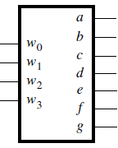
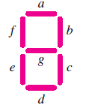
Code Converters
The purpose of the decoder and encoder circuits is to convert from one type of input encoding to a different output encoding.
For example, a 3-to-8 binary decoder converts from a binary number on the input to a one-hot encoding at the output. An 8-to-3 binary encoder performs the opposite conversion.
There are many other possible types of code converters. One common example is a BCD-to-7-segment decoder.
A similar decoder is often used to display hexadecimal information on seven-segment displays.
A hex-to-7-segment decoder can be implemented as shown in figure.

Slide 39
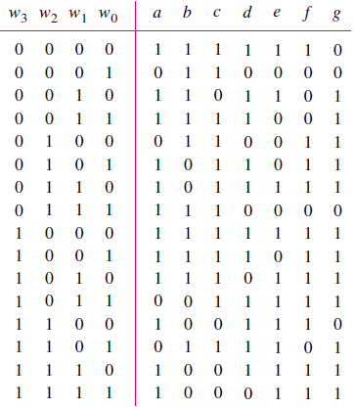
A hex-to-7-segment display code converter
Digits 0 to 9 are displayed the same as in the case of the BCD-to-7-segment decoder.
Digits 10 to 15 are displayed as A, b, C, d, E, and F.
This circuit can be implemented in the way we have already studied.
Although the word decoder is traditionally used for such circuits, a more appropriate term is code converter.
The term decoder is more appropriate for circuits that produce one-hot encoded outputs

Slide 40
Arithmetic Comparison Circuits
In computer computations it is often necessary to compare numbers.
Comparator is a type of arithmetic circuit that compares the relative sizes of two binary numbers.
Assume we have to compare two n-bit inputs, A and B, which represent unsigned binary numbers.
The comparator produces three outputs, called AeqB, AgtB, and AltB.
The AeqB output is set to 1 if A and B are equal.
The AgtB output is 1 if A is greater than B, and the AltB output is 1 if A is less than B.
The desired comparator can be designed by creating a truth table that specifies the three outputs as functions of A and B.
However, even for moderate values of n, the truth table is large.
A better approach is to derive the comparator circuit by considering the bits of A and B in pairs.

Slide 41
4 bit comparator
We can illustrate the comparator design by a small example, where n = 4.
Let A = a₃a₂a₁a₀ and B = b₃b₂b₁b₀.
Define a set of intermediate signals called i₃, i₂, i₁, and i₀.
Each signal, i_{k} , is 1 if the bits of A and B with the same index are equal.
Hence,
The comparator’s AeqB output is then given by AeqB = i₃i₂i₁i₀
An expression for the AgtB output can be derived by considering the bits of A and B in the order from the most-significant bit to the least-significant bit.
The first bit-position, k, at which a_{k} and b_{k} differ determines whether A is less than or greater than B.

Slide 42
Contd.
If a_{k} = 0 and b_{k} = 1, then A < B. But if a_{k} = 1 and b_{k} = 0, then A > B.
The AgtB output is defined by,
The i_{k} signals ensure that only the first bits, considered from the left to the right, of A and B that differ determine the value of AgtB.
The AltB output can be derived by using the other two outputs as
This approach can be used to design a comparator for any value of n.

Slide 43
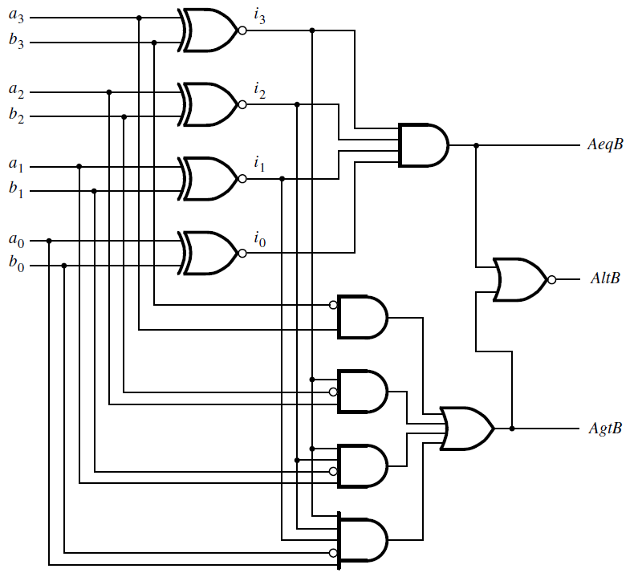
4 bit comparator
AeqB = i₃i₂i₁i₀

Slide 44
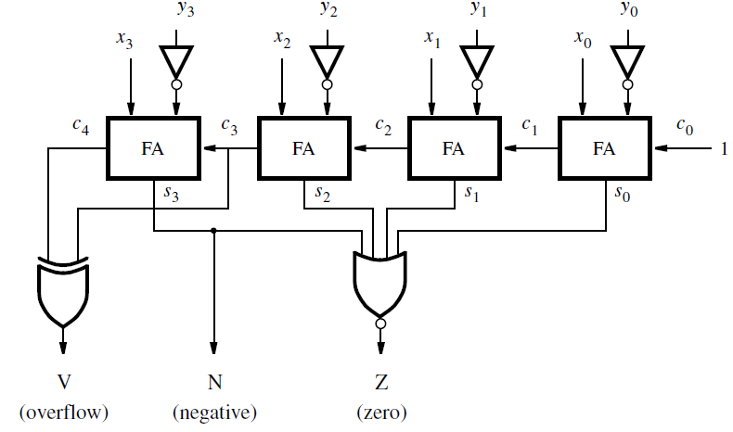
Comparator for signed numbers
Two 4-bit signed numbers, X = x₃x₂x₁x₀ and Y = y₃y₂y₁y₀, can be compared by using the subtractor circuit in Figure
It performs the operation X − Y .
*The three outputs denote the following:
*Z = 1 if the result is 0;
otherwise Z = 0
*N = 1 if the result is negative; otherwise N = 0
*V = 1 if arithmetic overflow occurs; otherwise V = 0
*Z, N, and V can be used to determine the cases X = Y , X < Y , X ≤ Y , X > Y, and X ≥ Y .

Slide 45
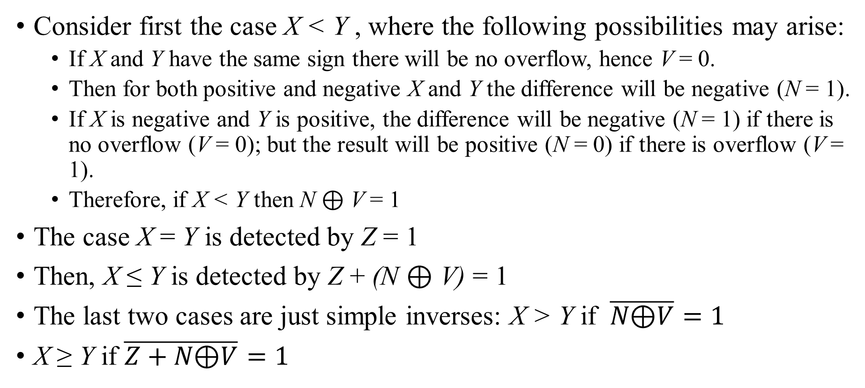
Contd.
Consider first the case X < Y , where the following possibilities may arise:
If X and Y have the same sign there will be no overflow, hence V = 0.
Then for both positive and negative X and Y the difference will be negative (N = 1).
If X is negative and Y is positive, the difference will be negative (N = 1) if there is no overflow (V = 0); but the result will be positive (N = 0) if there is overflow (V = 1).
Therefore, if X < Y then N ⊕ V = 1
The case X = Y is detected by Z = 1
Then, X ≤ Y is detected by Z + (N ⊕ V) = 1
The last two cases are just simple inverses: X > Y if $\overline{N\text{⊕}V}=1$
X ≥ Y if $\overline{Z+N\text{⊕}V}=1$

